Slide 1
Primary Music Meet Up
Successful Curriculum Planning
Why this and Why now - AND…
Why we do what we do - and why we should keep doing it!

Slide 2
Contact - Molly Newton: Learning Lead - York Music Hub to arrange an initial visit and planning meeting
molly@yorkmusichub.org.uk
Notes:
Surviving Autumn 1

Slide 3
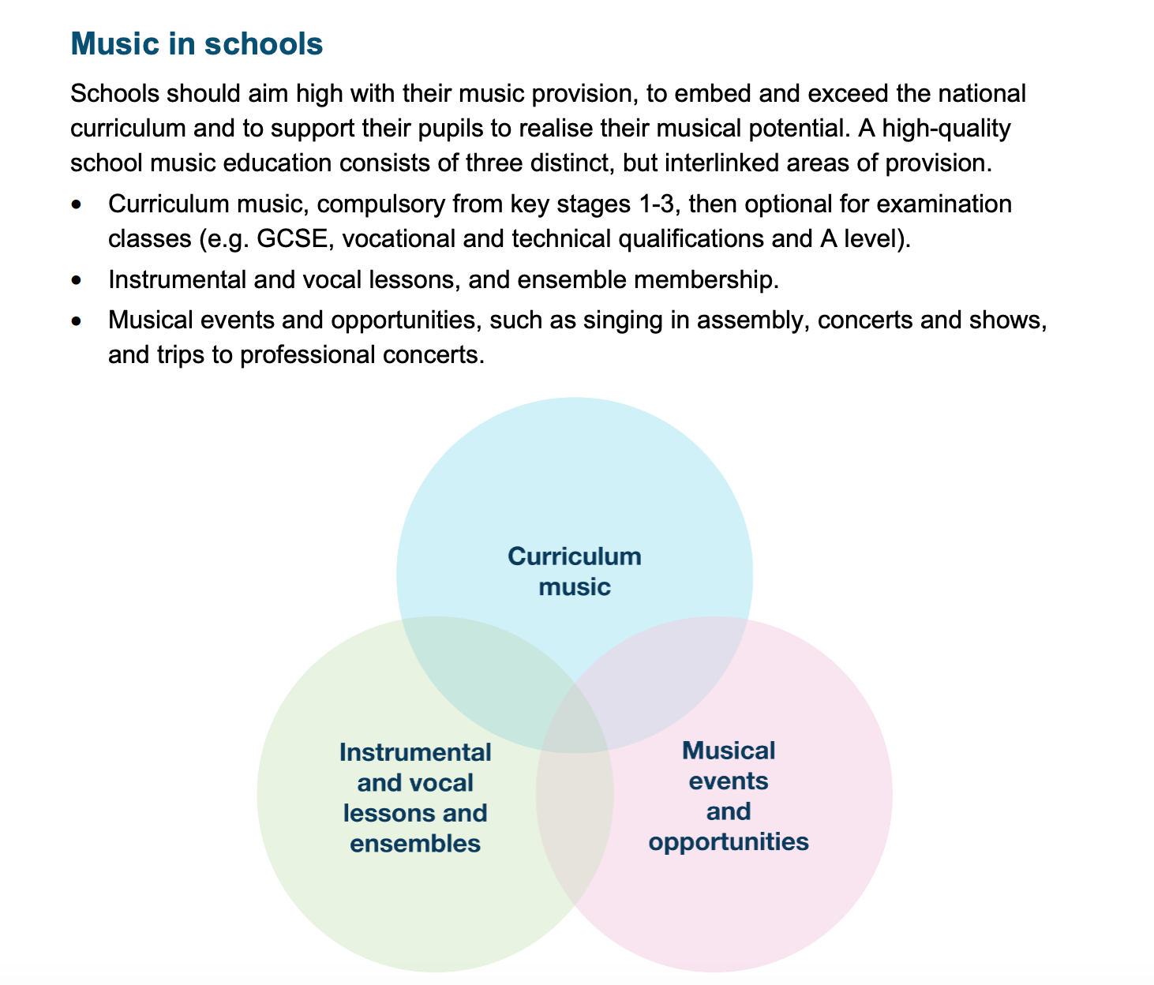
What does an outstanding Music curriculum look like in a primary school?
Yes this is the same slide as last time…

Slide 4
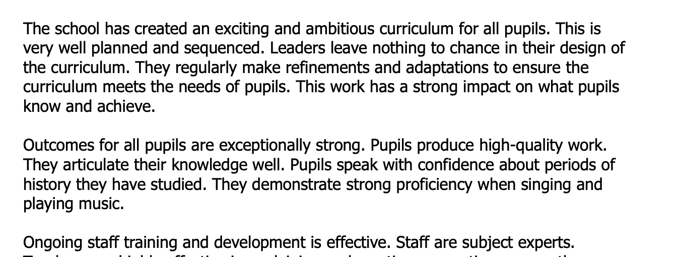
What does an outstanding Music curriculum look like in a primary school?
Discussion with Diane Martin Music Lead at Lord Deramores and
Haxby Road Primary Academy
Link to Deep Dive Questions

Slide 5
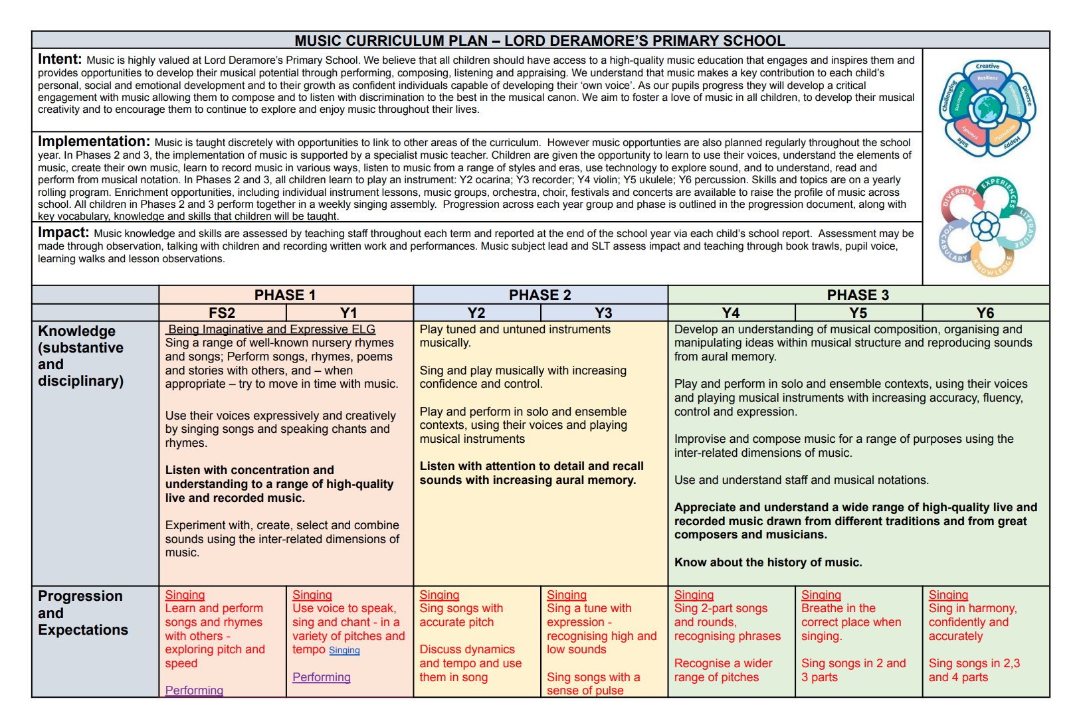
What does an outstanding Music curriculum look like in a primary school?
Discussion with Diane Martin Music Lead at Lord Deramores and
Haxby Road Primary Academy

Slide 6
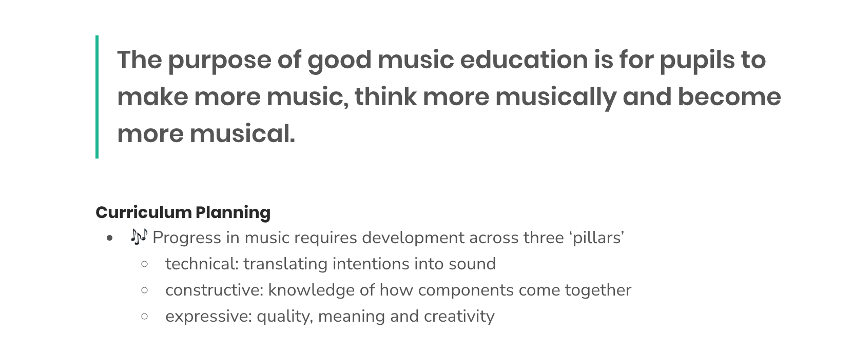
What does an outstanding Music curriculum look like in a primary school?

Slide 7
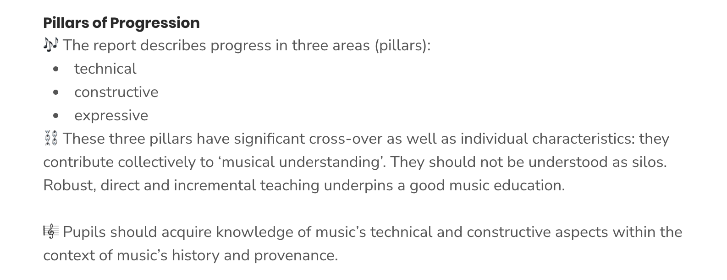
What does an outstanding Music curriculum look like in a primary school?

Slide 8
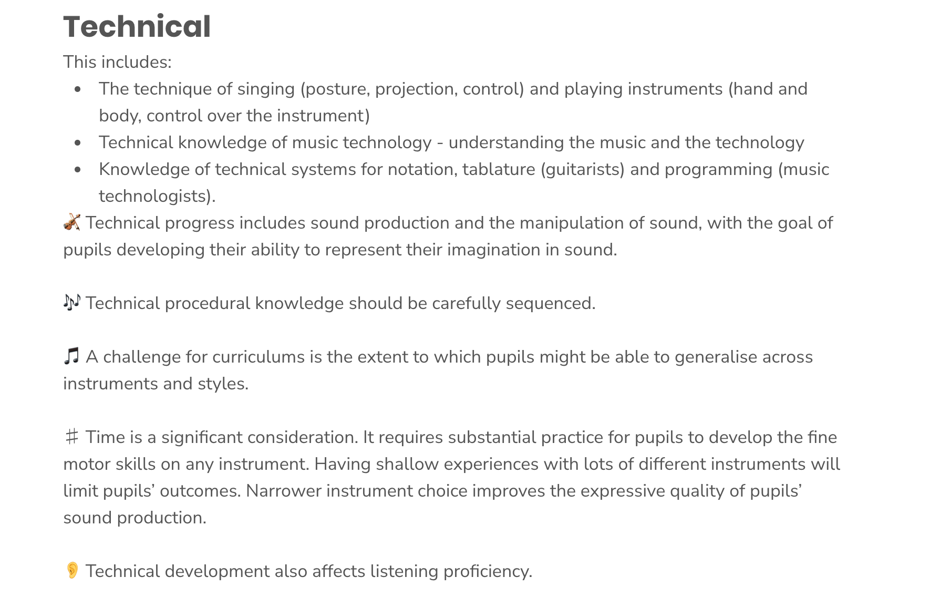
What does an outstanding Music curriculum look like in a primary school?
Link to Deep Dive Questions

Slide 9
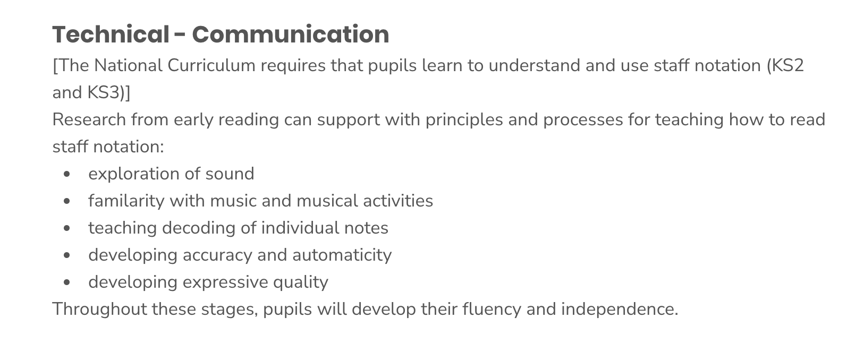
What does an outstanding Music curriculum look like in a primary school?
Link to Deep Dive Questions

Slide 10
What does an outstanding Music curriculum look like in a primary school?
Link to Deep Dive Questions

Slide 11
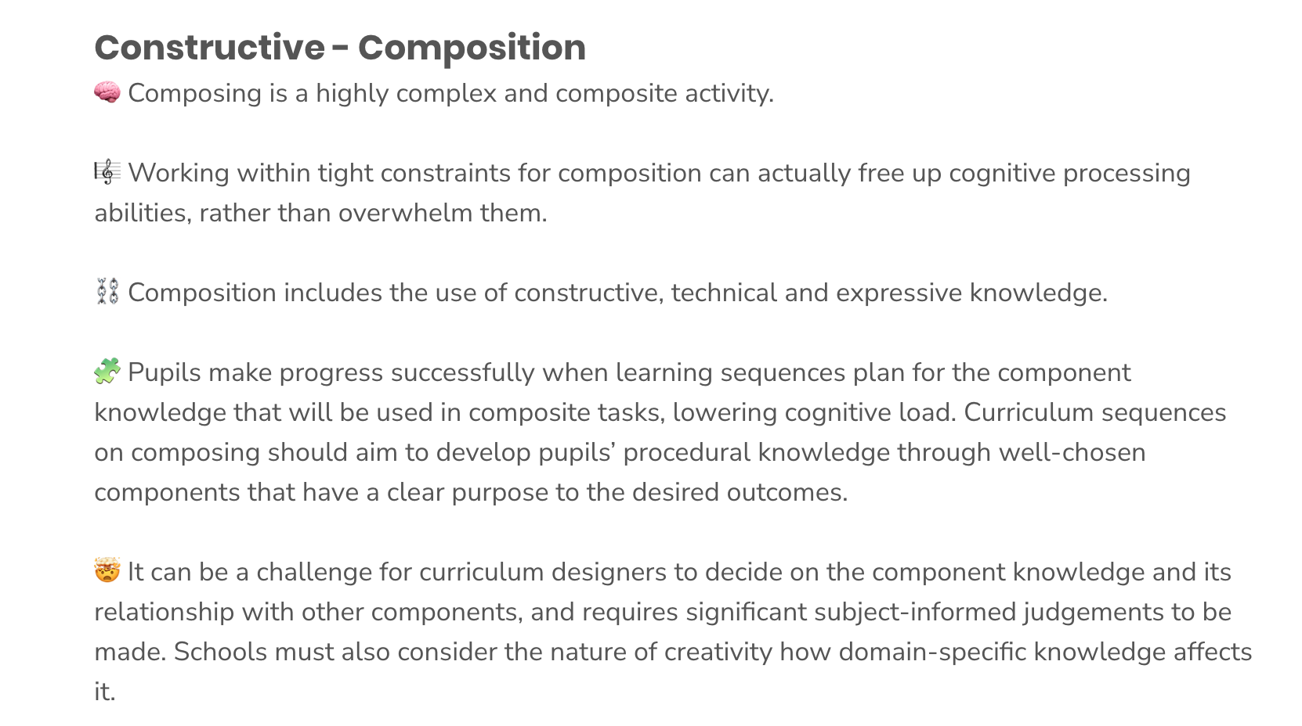
What does an outstanding Music curriculum look like in a primary school?
Link to Deep Dive Questions

Slide 12
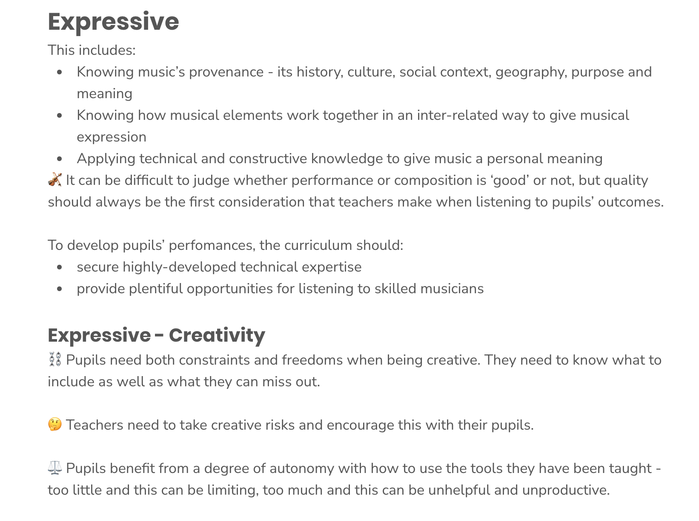
What does an outstanding Music curriculum look like in a primary school?
Link to Deep Dive Questions

Slide 13
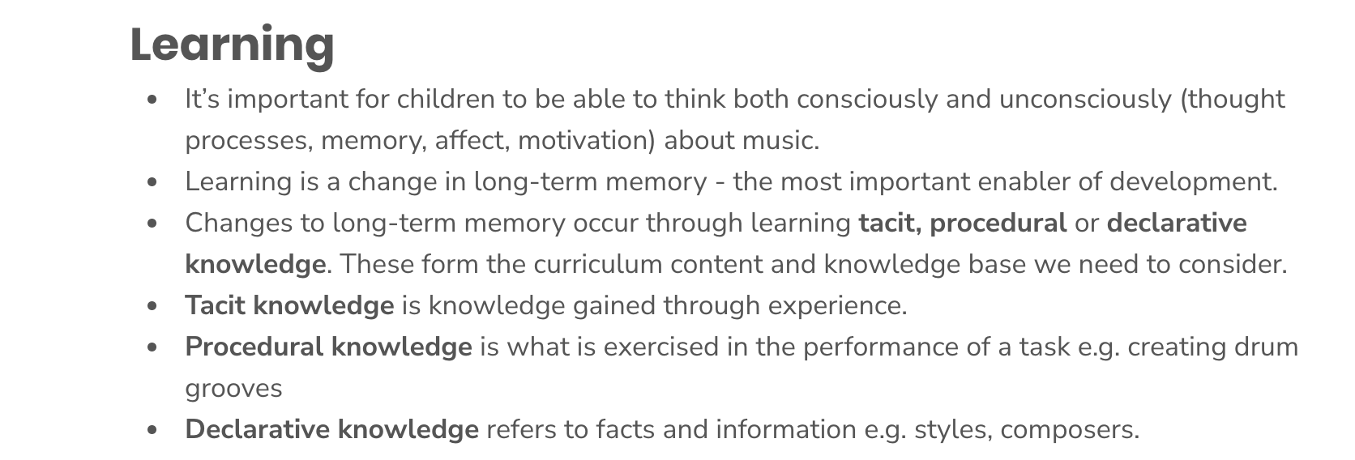
What does an outstanding Music curriculum look like in a primary school?
Link to Deep Dive Questions

Slide 14
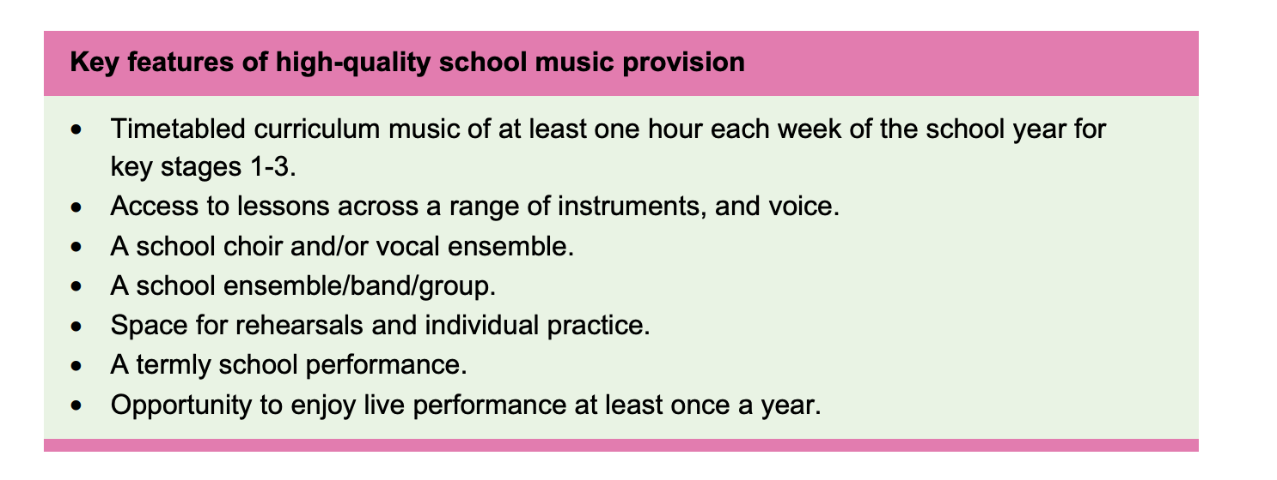
The focus for today…

Slide 15
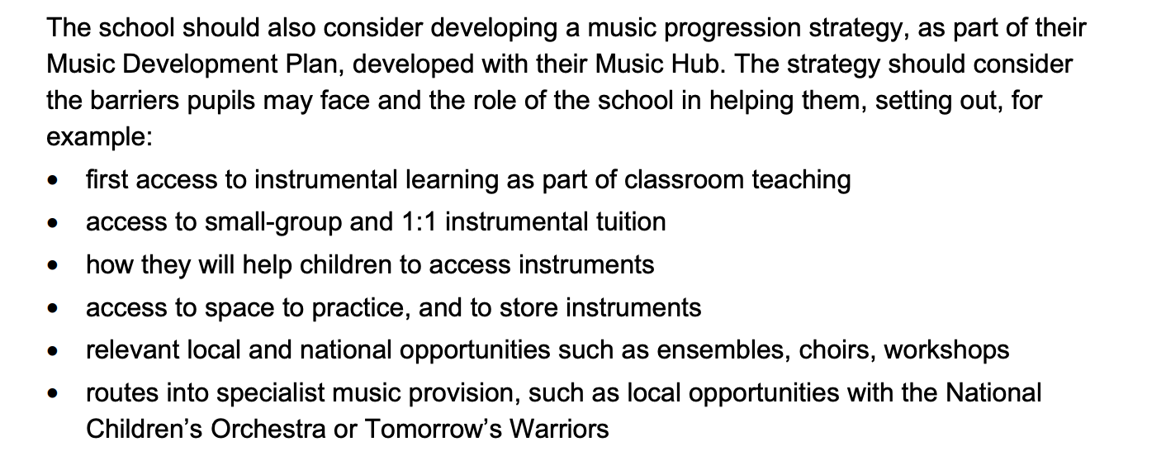
“What it means to make progress in music is many faceted. No two journeys, in and through musical learning, are the same. Nevertheless, everyone starts from an initial inspiring experience of music, either hearing or performing it” – The Music Commission. What does it take to make progress in music? 2019.

Slide 16
Link HERE to summary document

Slide 17
Ofsted’s Christopher Stevens, HMI National Lead for music, explains what to expect from a Deep Dive in music in 2023.
Click HERE to see the full interview…

Slide 18
More from Christopher Stevens

Slide 19
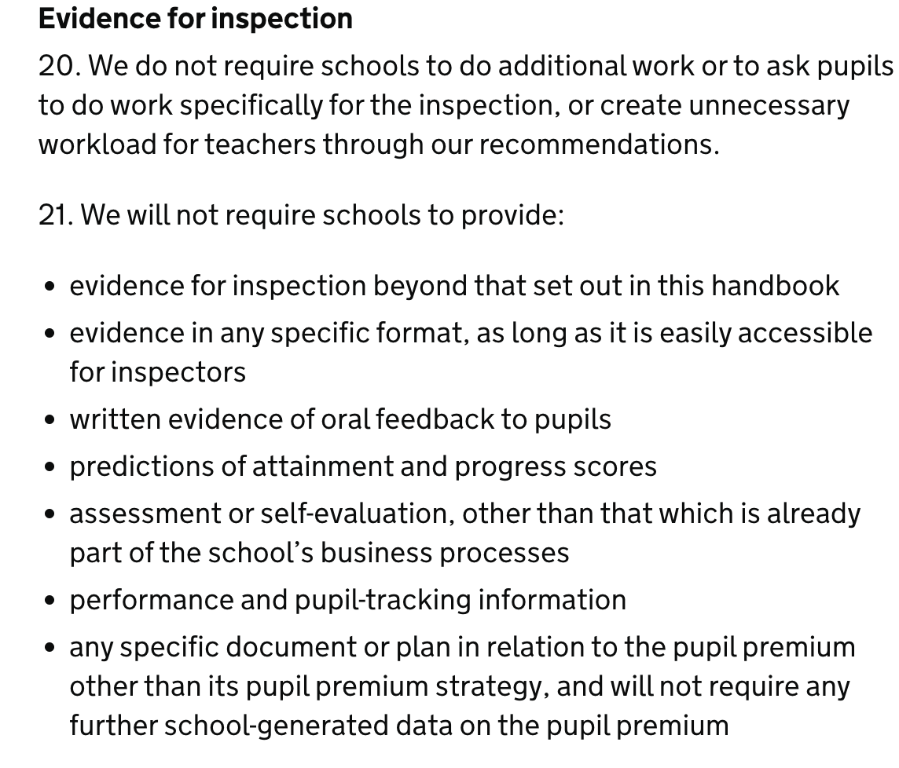
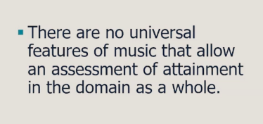
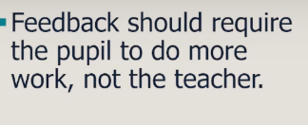

Slide 20
Why this? Why now?How to plan a curriculum to support progression in music…

Slide 21
Why this Why Now? Online Curriculum planning:
There are various online schemes available and all have different things to offer.
Sing Up
Charanga
Musical Futures Online

Slide 22
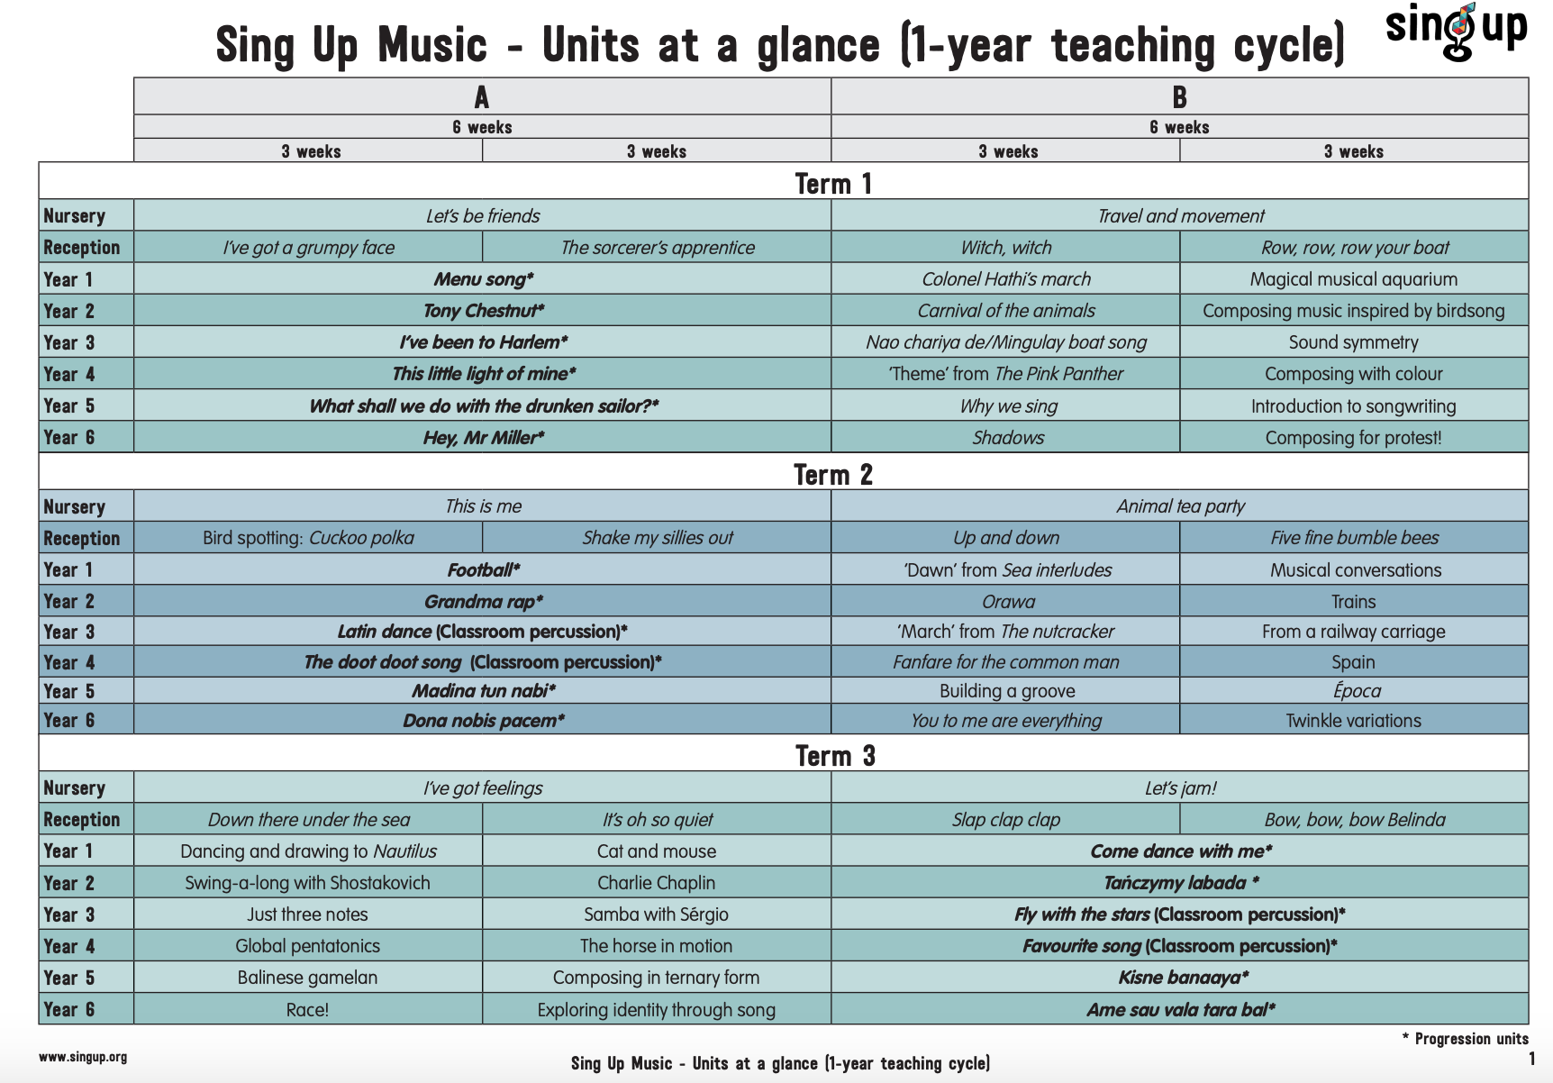
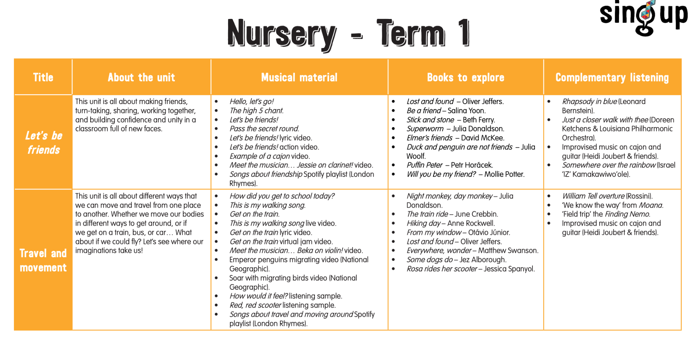
Why this Why Now? Online Curriculum planning:
Costs:
Small Primary Schools (less than 100) £62 annual membership
Medium Primary Schools (101 - 200) £90 annual membership
Large Primary Schools (200+) £114
annual membership
YMH Subsidised

Slide 23
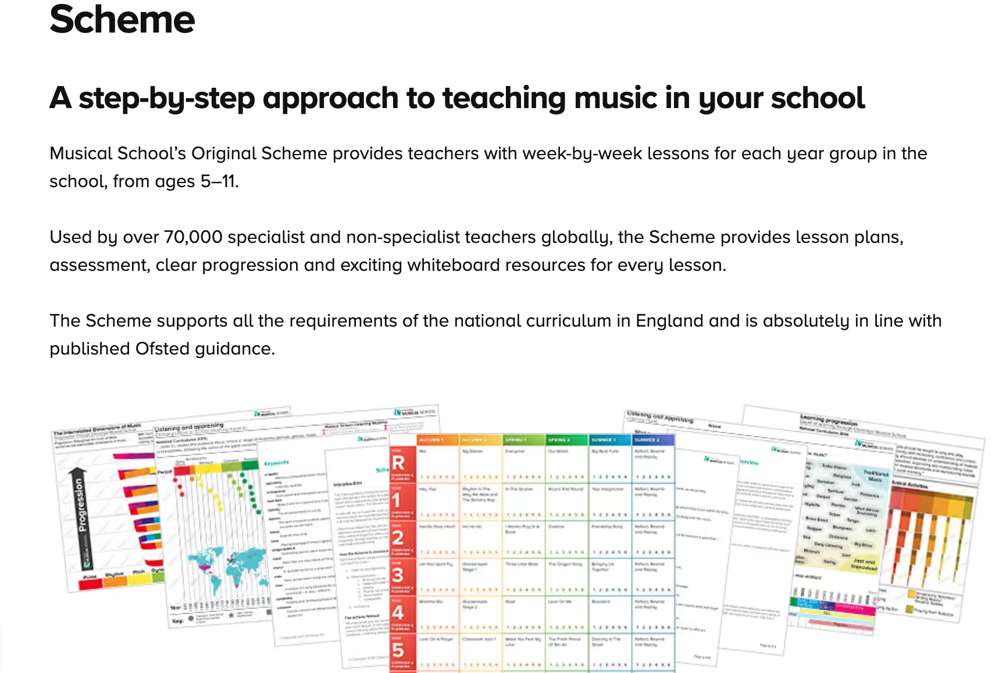
Why this Why Now - Online Curriculum planning:
Costs:

Slide 24
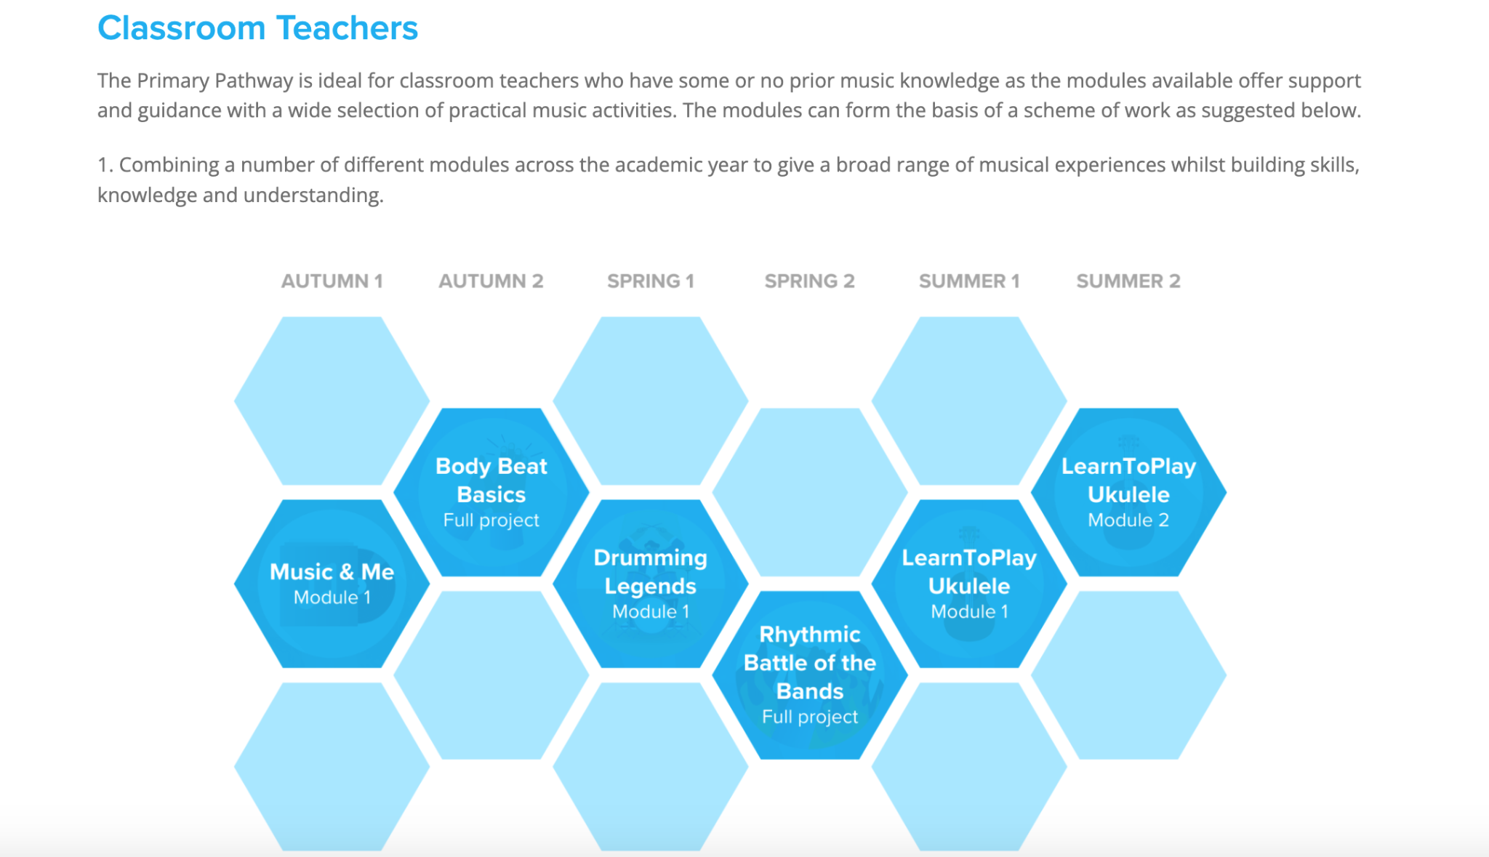
Why this Why Now - Online Curriculum planning:

Slide 25
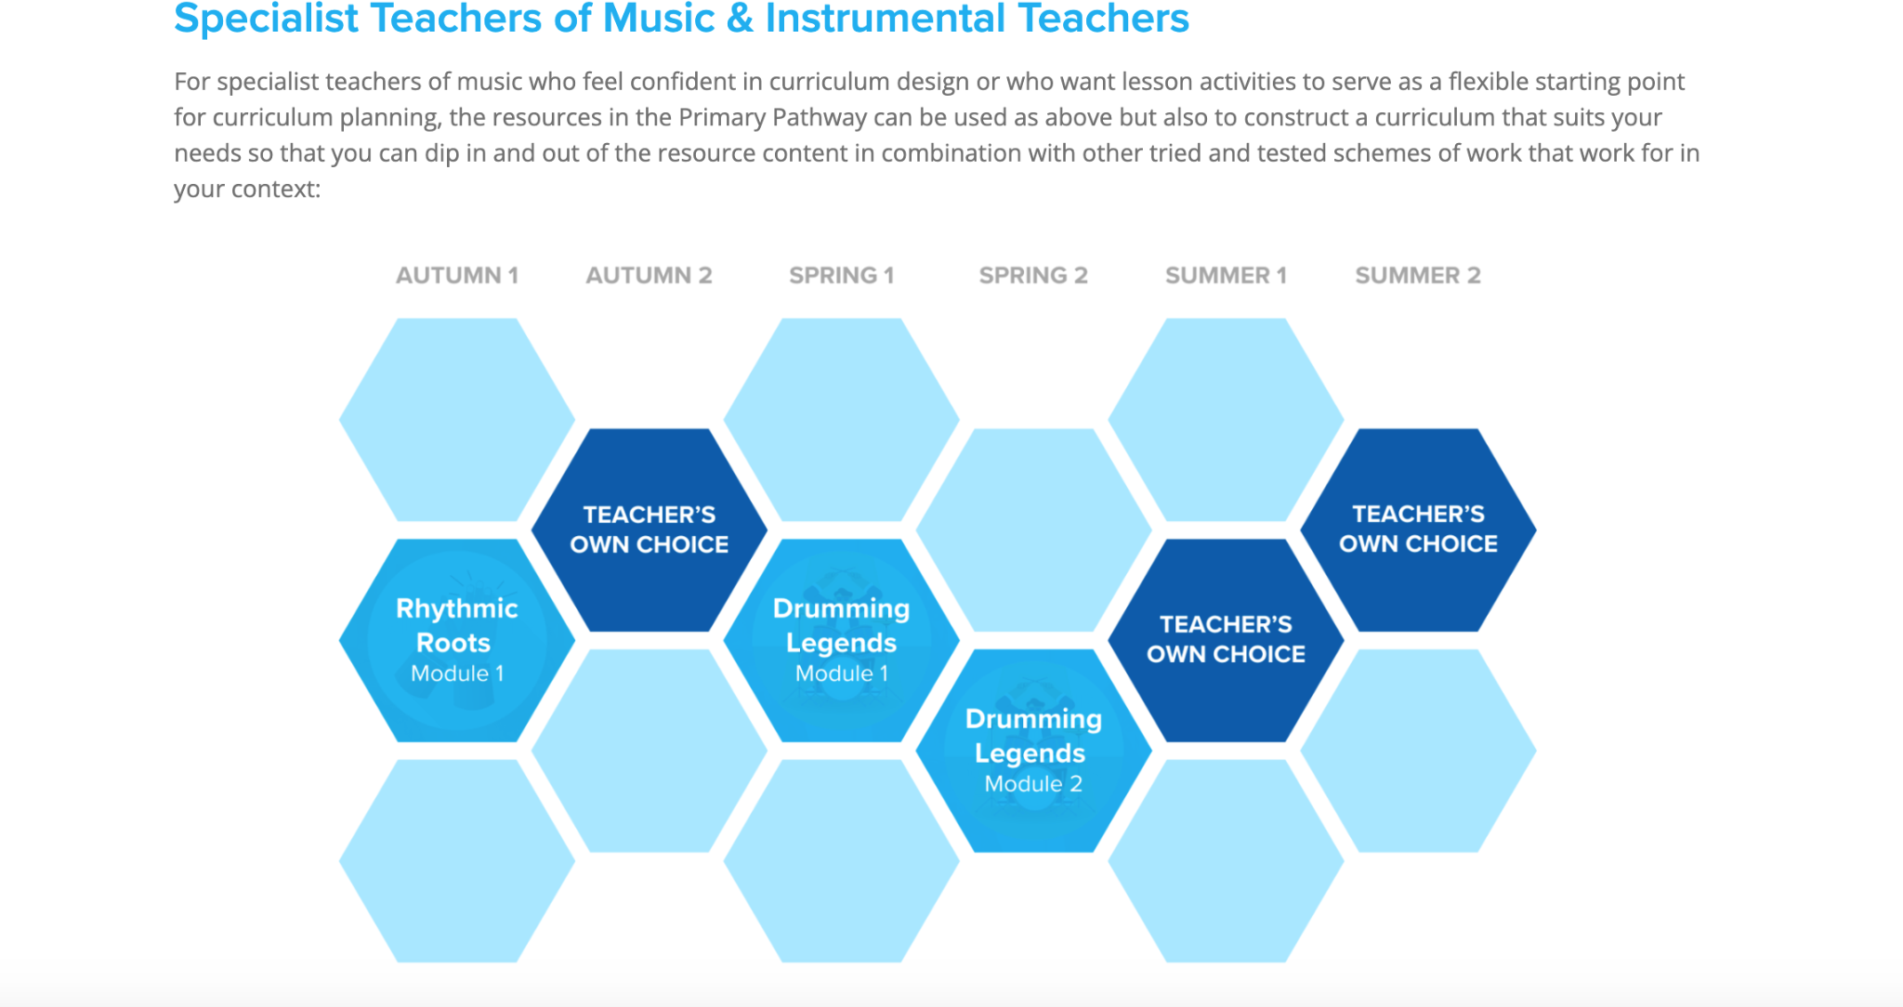
Why this Why Now - Online Curriculum planning:

Slide 26
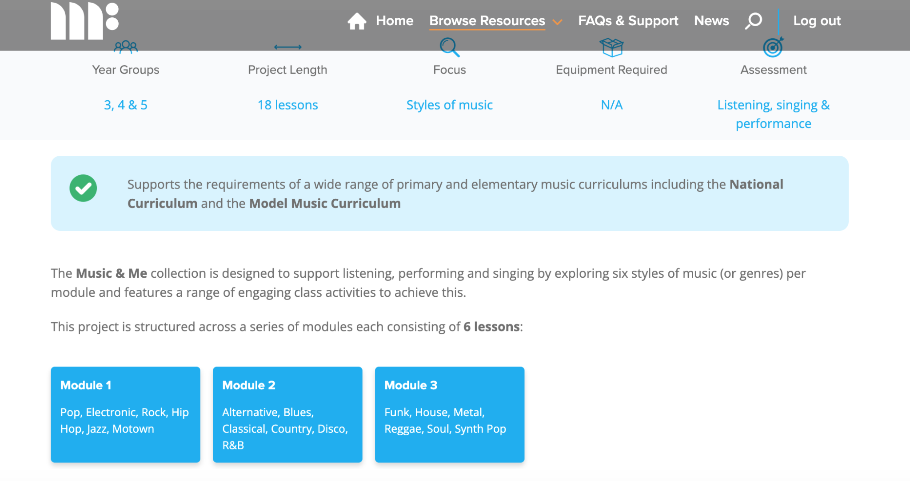
Why this Why Now - Online Curriculum planning:

Slide 27
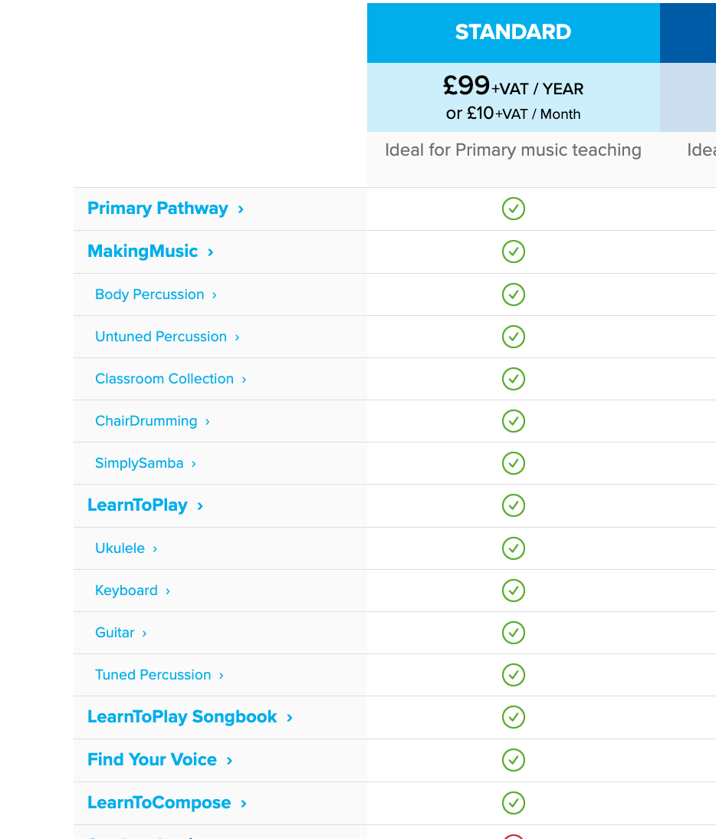
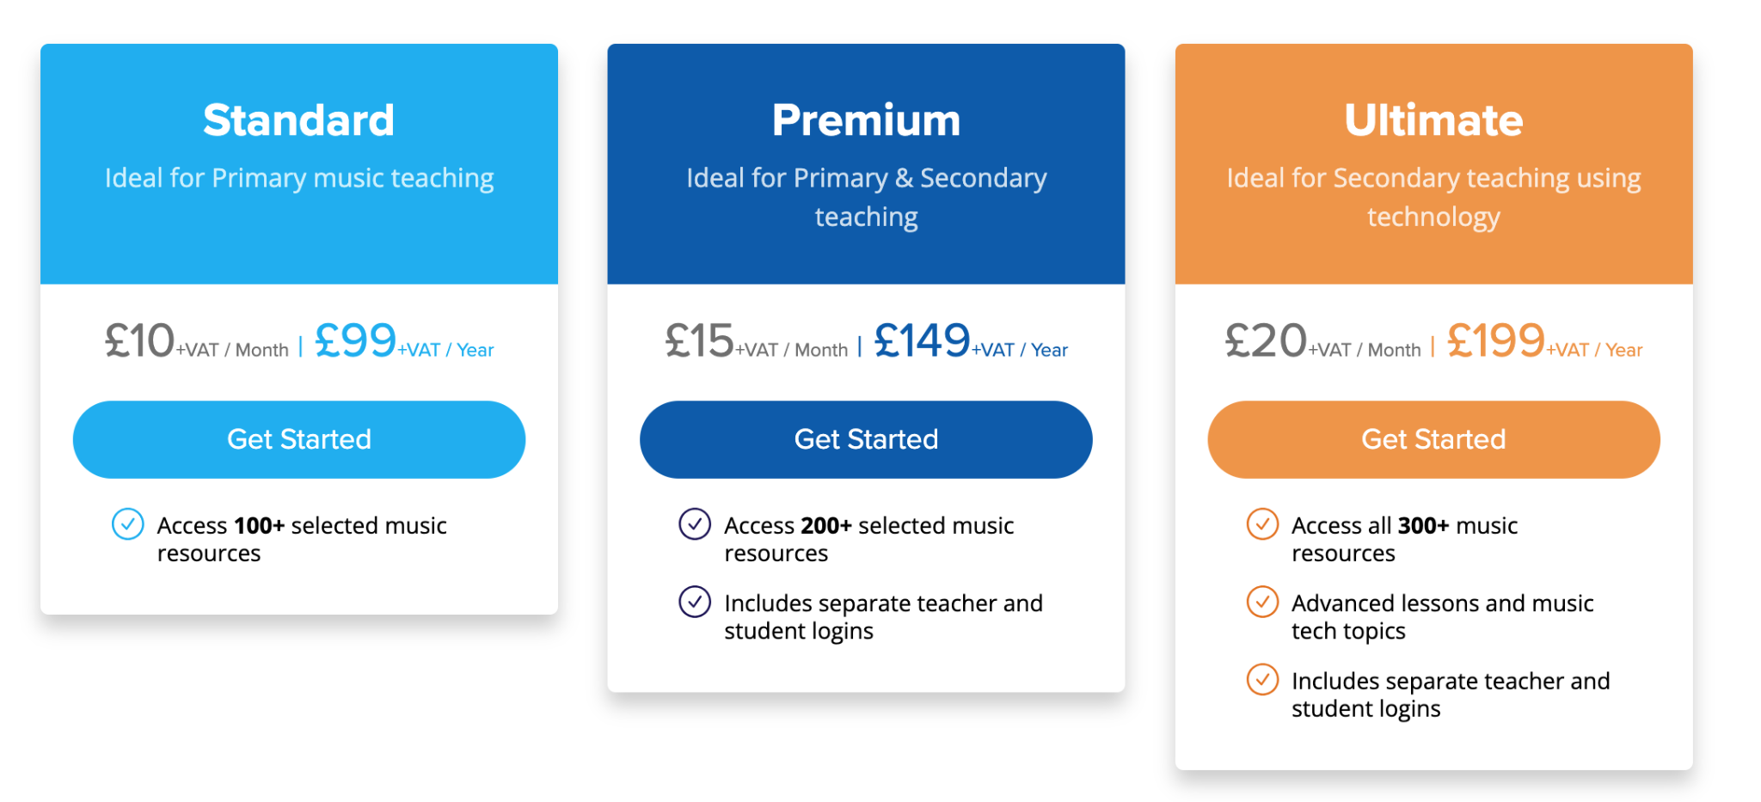
Why this Why Now - Online Curriculum planning:
Musical Futures Online
Costs:

Slide 28
Primary Music Meet Up
Hub Updates:
Energy (resources on our website)
OAE
Instrument Class Set Catalogue

Slide 29
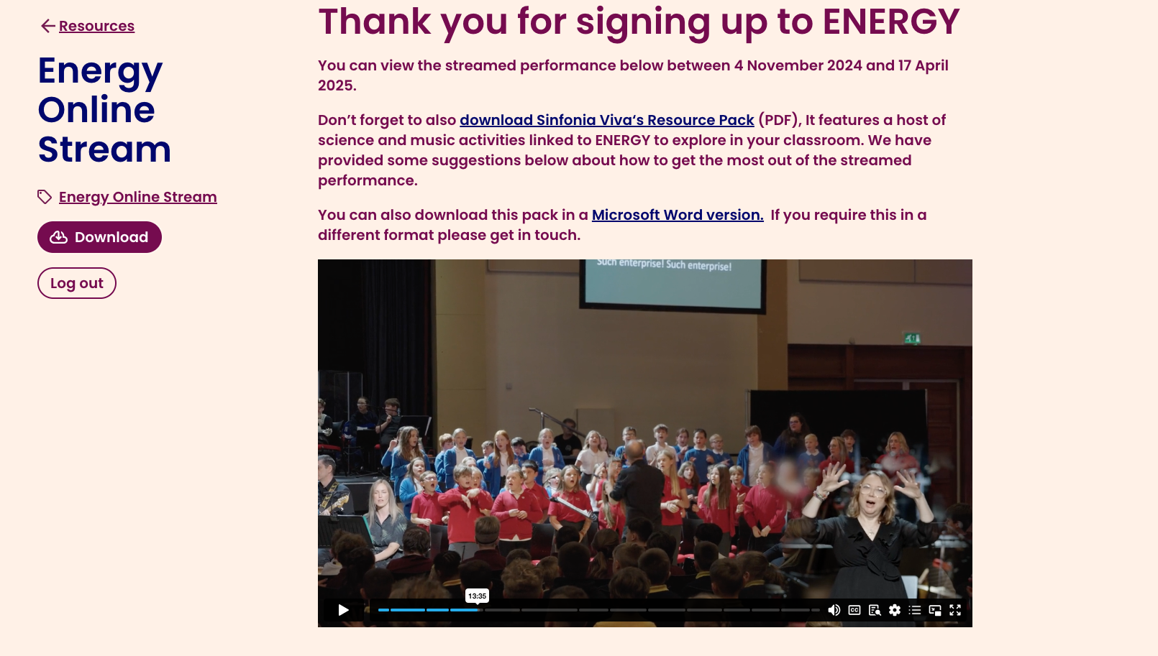
Energy KS2 Music and Science project
All Energy resources, including audios, videos, lyrics, music scores and Teacher Resource Pack can be found on our website, under the ‘Resources for Schools’ tab.
But can be accessed here too Click here for resources. It is a Sharepoint folder.

Slide 30
OAE
OAE - Orchestra and the Age of Enlightenment
6 primary schools (Y3 or Y4? Up to 4FE)
All resources online
CPD session at NCEM
One workshop in each school (20th or 21st May)
4 x Afternoon performance at the Jack Lyons (no audience) 11th June
£100
2 x Evening performance at Jack Lyons ticketed event 11th June
£200, perform alongside a Community Choir, a secondary school orchestra and or course the whole OAE ensemble

Slide 31
Instrument Class Set Catalogue
Department for Education - York Music Hub funded £73,000 for new instruments
30% to be ordered now
Next 30% by April, then 30% August
After ‘3 Quick Questions’ responses from schools requesting school need for instruments, the order has been placed.
From April
Instrument Class Set Catalogue will be running.
Booking Form link will ‘go live’ from February half-term
All bookings will be for whole term
£50 for any class set (includes drop off and pick up)
Please start to plan your curriculum accordingly
From July - September
More instruments to be added
York Music Hub will also hold a small selection of (new) individual instruments to hire eg clarinets, flutes, violins

